Slide 1
Skyline Query

Slide 2
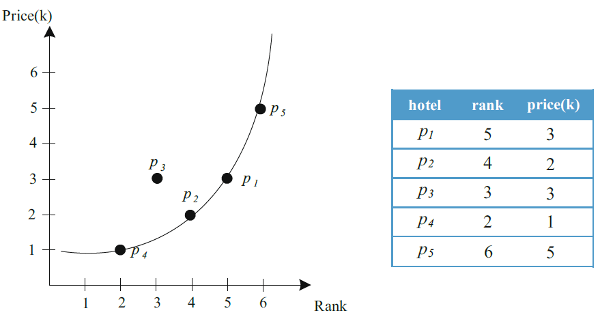
Skyline query
Finding points not dominated by any other object, in terms of m dimensions
p dominates p’ if its value in each dimension is as good or better than that of p’ and is better in at least one dimension
p₁ dominates p₃

Slide 3
上台 Demo
一組 1~4人
Input data，當天給定
建構3D R-tree (optional)
執行 skyline query 找出 skyline points
using 3D R-tree
brute-force method
繳交紙本

Slide 4
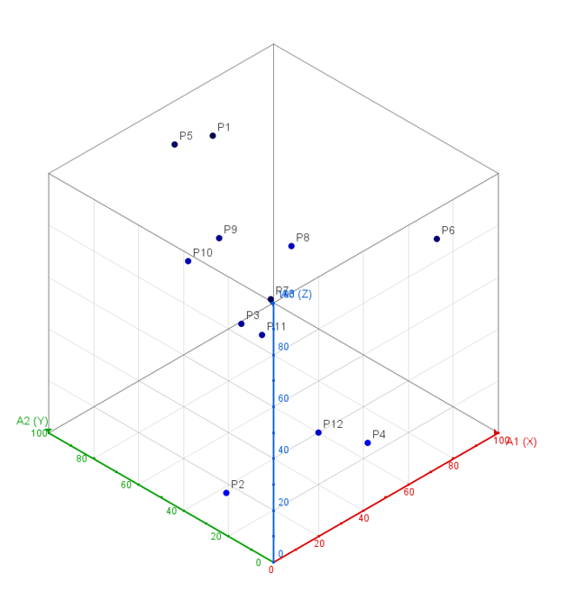
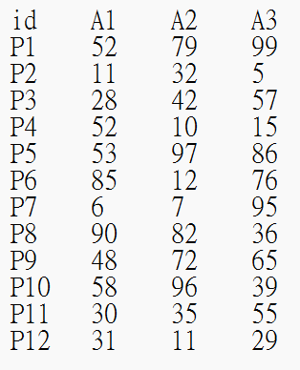
輸入資料
Input: point.txt
值介於1~100

Slide 5
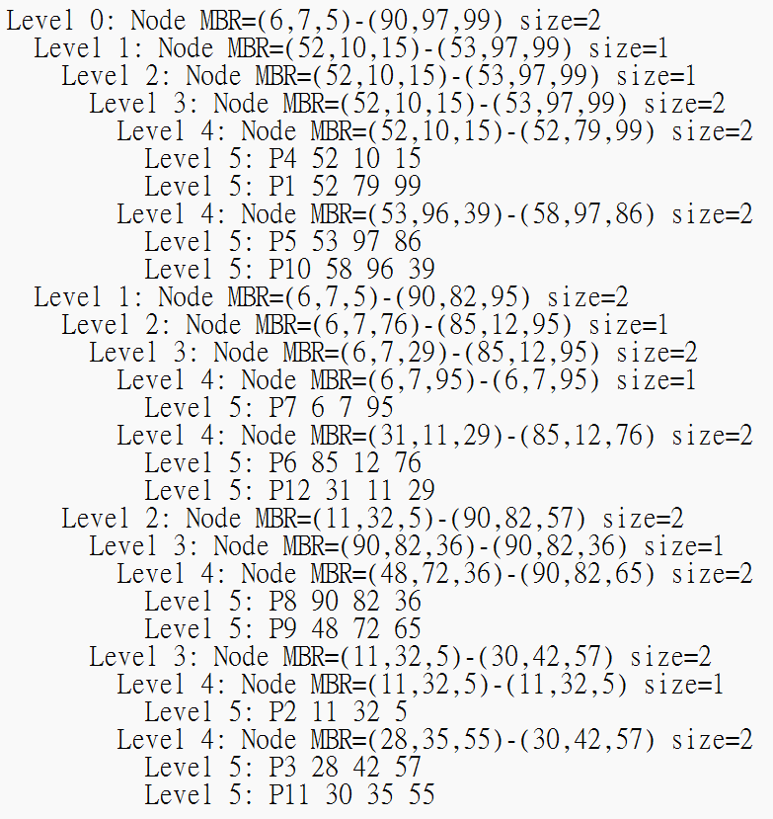
建構 3D R-tree

Slide 6
執行 skyline query

